Slide 1

Internship at
Name: Md. Abu Salman Hossain
Department of Software Engineering
Registration No. 2018831067
Notes:
Assalamu alaikum and good morning.
I am Md. Abu Salman Hossain and Today I would like to share my experience during my internship at vivasoft limited.

Slide 2

About Vivasoft
Vivasoft has grown to nearly 200+ employees in just Seven years.
They have two branches in Dhaka and Rajshahi.
They are working on more than 10 projects currently.
They deploy World-Class Agile Product on Demand.
Motto of this organization is “Let’s Build Our Future Together”.
Notes:
Vivasoft limited is a software company that has achieved impressive growth in just seven years, with a team of over 200 employees……… (slide)

Slide 3
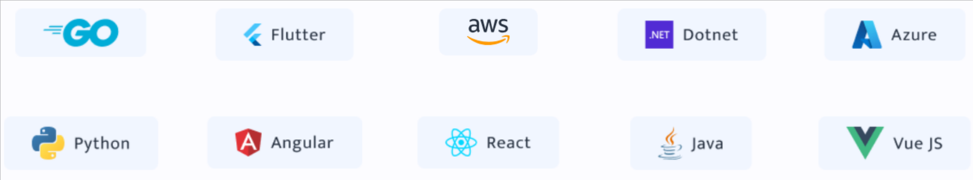
Technologies Used in Vivasoft
Entrusting the new technology to the most advanced programmers will ensure a more robust and high-performing system
Notes:
At vivasoft, they worked with various technologies such as go, flutter…………..(slide)

Slide 4
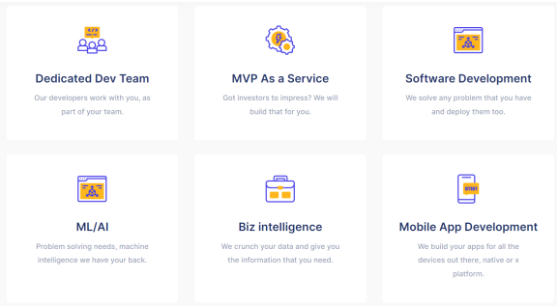
Vivasoft services
Notes:
They offer many features such as dedicated dev team ………(slide)

Slide 5

Internship Plan of Vivasoft
Roadmap
Vivasoft designed a roadmap
for interns and fresh graduates
Courses and Bootcamps
They have also created bootcamps
for various technologies
Healthy Learning Environment
Vivasoft tries to ensure dedicated
mentor for every interns and fresh graduates
01
1
2
3
Notes:
The internship plan of vivasoft has three main features. Which are roadmap, courses & bootcamps, healthy learning environment.

Slide 6
My Internship Activities
Whole Internship can be divided in Two Phase
01
02
Initial Learning
Real World Tasks
The total timeline of this period was nearly One and half months. I studied various topics and implement them in code
I have assigned in real life projects and worked with different teams.
Notes:
My internship at vivasoft was divided into two main phase. The learning period and the real world tasks.
The learning period spanned a month and a half, during which ……………next

Slide 7





Initial Learning Phase
Reading Documentations & Tutorials
Creating CRUD Application
Writing Golang Bootcamp article in Bangla
Involvement in live project
(Pi Inventory)
Notes:
I read documentations and tutorials about go and gorm, created CRUD application using this, wrote about golang in bangla bootcamp,
Then I was involved in a live project called Pi-Inventory.

Slide 8
Initial Learning Phase
Language, Frameworks and Tools
Language
Frameworks
Tools
Docker
Redis
Kafka
RabbitMQ
MySQL
PostgreSQL
Gitea
Bitbucket
Golang (Go)
Echo
Gin
Notes:
The language, I learned in my learning phases is golang, frameworks are echo & gin,
Tools are docker, redis…….(slide)

Slide 9
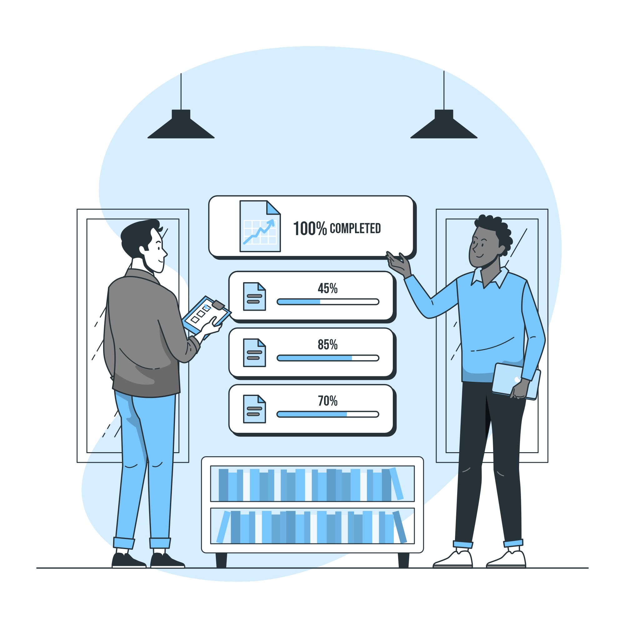
Real World Tasks
Pi Inventory
This product will manage the client’s under Vivasoft’s Financify initiative.
Stock Creation
Stock Adjustment
Stock Management through Financify invoice
Fortunately, I took part in the entire life cycle of software development from requirement gathering to deployment.
Notes:
After learning this, I used them in the backend development process of pi-inventory………(slide)

Slide 10






Technology Used in Backend Development
Golang
Gin
PostgreSQL
Backend Language
Gin used for Backend API
PostGreSQL Server as Relational Database
Docker
Redis
Postman
Docker used for Deployment
Redis used for Server Site Cache
Postman used for Backend API Testing
Notes:
The technologies used in backend development go, gin ……..(slide)

Slide 11
Responsibilities
Develop APIs For Stock management, tasks, user dashboard and team module etc.
Run the project in container and deploy in local server using docker.
Used Redis for caching and faster response.
Helping in Database design
And redesign after seniors review
Used PostgreSQL for transaction, commit and rollback.
Manual Testing for both API and UI. Also working to fix the Bugs
Notes:
My responsibilities in the project development were ……(slide)

Slide 12
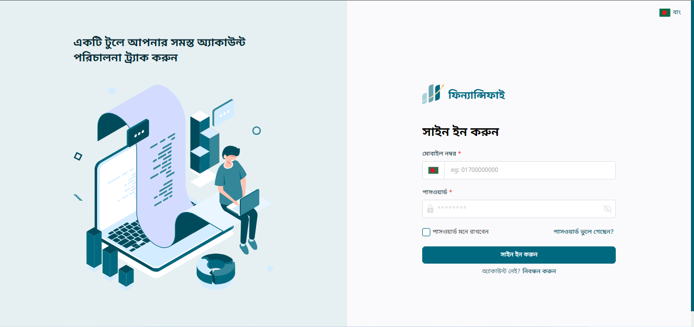
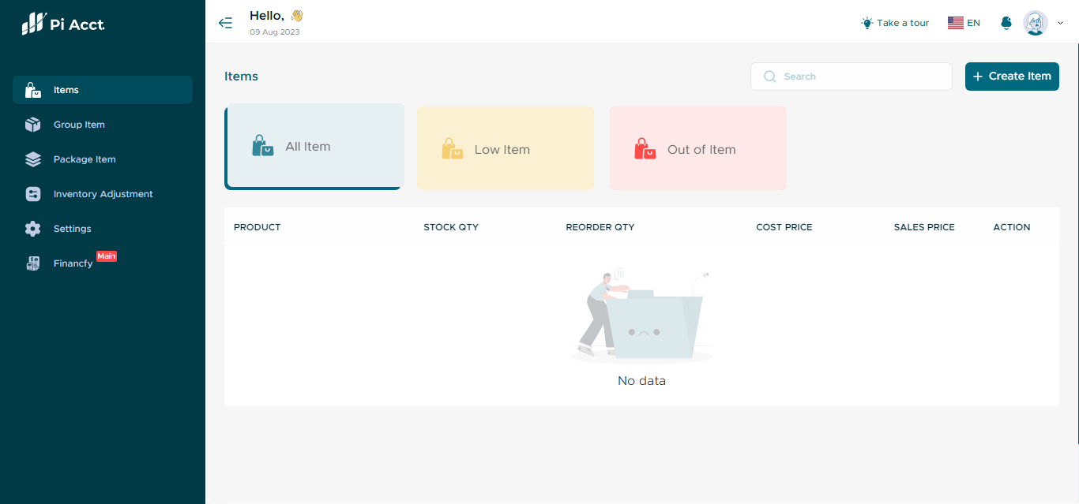
Notes:
This are the screenshot of the project I was part of…….(slide)

Slide 13
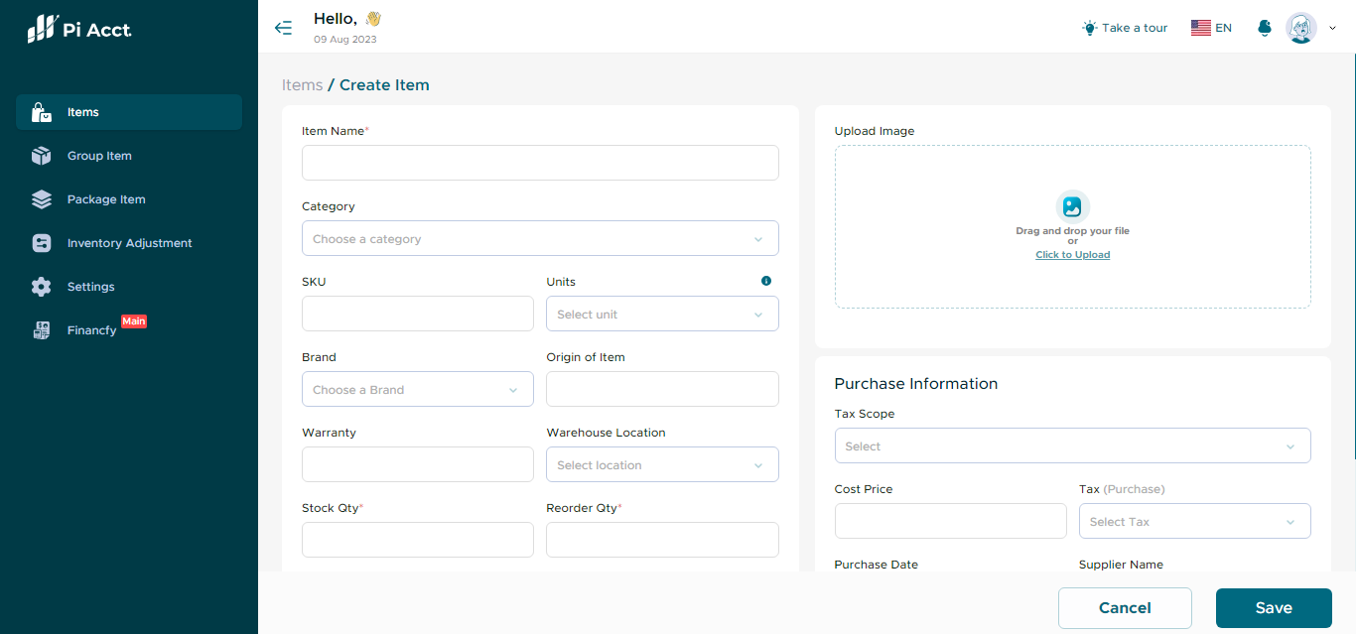
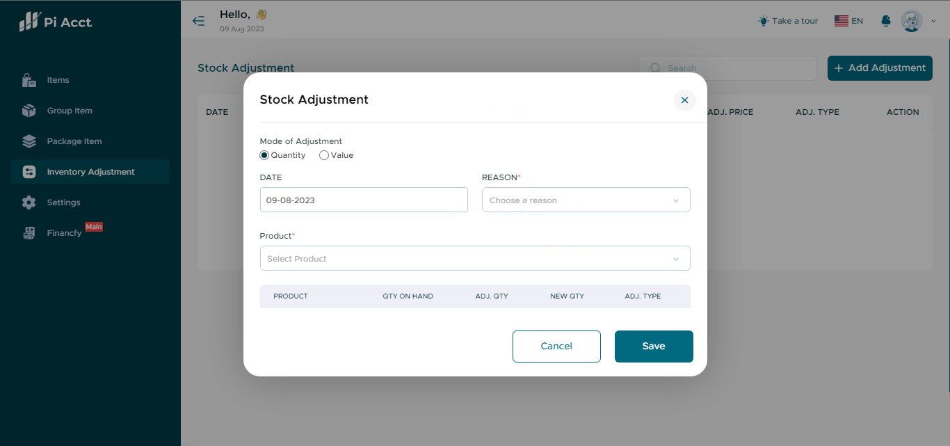

Slide 14
Challenges & Personal Growth
Challenges
Personal Growth
Maintaining coding structure and best practices all the time.
Understanding the micro-service architecture.
Adapting to new technologies.
Communicating to the team-mates due to home office.
Sharing knowledge due to home office.
Pre-planning skill
Efficiency in Team-work
Pair Programming
Punctuality
Communication skill
Learning new languages
Better understanding of Code formation (Smell, Refactoring)
Notes:
Challenges I faced ……(slide)
And Personal growth I achieved …..(slide)

Slide 15
Thank You!

